Slide 1

PANDORA HACKATHON 2026
AI Business Support Bot
Theme- AI + n8n Automation
Team Name: NodeMinds
Team Members:
Nitesh Ranjankar
Ashish Deshmukh
Sarthak Bhalearo
Alina Pathan

Slide 2
PROBLEM STATEMENT
NodeMinds
To addresss the problem Small businesses frequently face challenges in providing timely and consistent customer support due to limited staffing, operational hours, and resource constraints. This often results in delayed responses, customer dissatisfaction, and missed business opportunities. There is a need for a cost-effective solution that ensures instant, personalized, and round-the-clock customer assistance without requiring additional human intervention or increased staffing expenses.
“Every delayed customer reply is a lost sale. We built an AI system that ensures that never happens again.”

Slide 3
NodeMinds
IDEA TITLE
🔹 Detailed Explanation of the Proposed Solution
🔹 How It Addresses the Problem
AI-powered automated customer support system for small businesses
Captures customer queries instantly through online Tally form
Processes and understands requests using Google Gemini AI
Automatically generates and sends personalized email responses
Logs all customer interactions securely in Google Sheets
Routes sensitive complaints and refund queries to human support
Provides instant 24/7 automated responses
Reduces manual workload and operational costs
Ensures structured and secure communication tracking and logging
🔹 Innovation and Uniqueness of the Solution
AI + Automation in one low-code workflow
Smart complaint/refund detection
Human fallback for sensitive cases
End-to-end automated support system
Scalable & cost-effective for SMEs

Slide 4
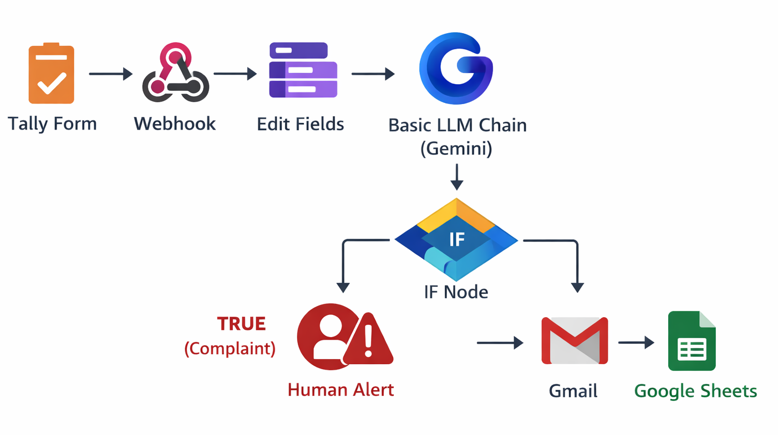
TECHNICAL APPROACH
NodeMinds
🔹 Methodology & Process for Implementation
🔹 Technologies to be Used
⚙️ Automation & Runtime
n8n — Workflow Automation Backbone
Node.js — Runtime Environment
🧠 AI Engine
Google GEMINI Model (gemini-1.5-flash) — AI Response Generation
🔗 Integration & Communication
Gmail API — Automated Email Delivery
Google Sheets API — Interaction Logging
Tally.so — Customer Query Form
ngrok — Public WebHook Tunnel

Slide 5
FEASIBILITY AND VIABILITY
NodeMinds
🔹 Analysis of Feasibility
Built entirely using reliable, widely available cloud APIs
Developed with low-code tools requiring minimal technical overhead
Requires no expensive servers or complex infrastructure setup
Quick deployment and testing within a few hours
Easily scalable for growing businesses without major upgrades
Cost-effective solution suitable for startups and SMEs
🔹 Potential Challenges & Risks
OAuth token expiry and authentication failures
Temporary service downtime
Misclassification of sensitive customer queries
🔹 Strategies to Overcome Challenges
Implement automatic credential refresh and reconnection mechanisms
Add retry logic, monitoring, and backup handling workflows
Enable human fallback with smart keyword-based routing

Slide 6
IMPACT AND BENEFITS
NodeMinds
🔹 Potential Impact on the Target Audience
Instant responses significantly enhance overall customer satisfaction
Empowers small businesses with reliable 24/7 support capability
Builds customer trust through consistent and professional communication
🔹 Benefits of the Solution
Social Impact
Enhances customer experience with faster responses
Economic Impact
Reduces operational and manpower expenses
Operational / Environmental Impact
Promotes paperless digital communication system

Slide 7
RESEARCH AND REFERENCES
NodeMinds
🔹 Research & Concept References
🔹 Official Documentation & APIs
AI in Customer Support : “How AI is transforming customer service” — industry article https://www.forbes.com/sites/forbestechcouncil/2023/01/17/how-ai-is-transforming-customer-service/
Chatbot vs AI Support : Comparative analysis of rule-based vs AI-powered support bots https://www.ibm.com/cloud/learn/chatbots-explained
Benefits of Automated Customer Support : Research on customer satisfaction from automated support systems https://www.gartner.com/en/documents/3995156
N8n : n8n Official Docs – Workflow automation basics & node configuration https://docs.n8n.io/
Google Gemini / Google AI Studio: Google Gemini API & model documentation https://aistudio.google.com/app/apikey
Google Sheets API : Google Sheets API docs & examples https://developers.google.com/sheets/api
🔹 Example Workflows & Integrations (Community)
n8n workflow examples & templates https://n8n.io/workflows
Google API sample apps on GitHub https://github.com/google

